Slide 1
Wireless Network and Layering
Chapter 3

Slide 2









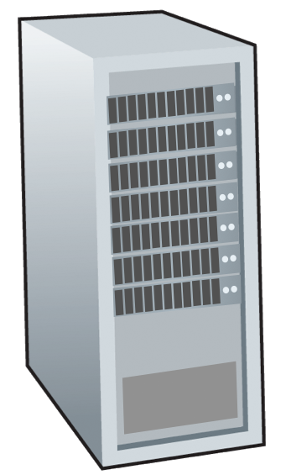






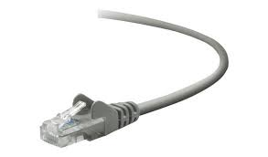
The Internet
Billions of connected computing devices:
  hosts = end systems
  running network apps at Internet’s “edge”
mobile network
national or global ISP
Packet switches: forward packets (chunks of data)
  routers, switches
local or regional ISP
Internet
Communication links
  fiber, copper, radio, satellite
  transmission rate: bandwidth
home network
content
provider
network
datacenter
network
Networks
  collection of devices, routers, links: managed by an organization
enterprise
network

Slide 3
The Internet
mobile network
4G
Internet: “network of networks”
  Interconnected ISPs
national or global ISP
Protocols are everywhere
  control sending, receiving of messages
  e.g., HTTP (Web), streaming video, Skype, TCP, IP, WiFi, 4G, Ethernet
IP
Streaming
video
Skype
local or regional ISP
home network
content
provider
network
Internet standards
  IEEE
  IETF: Internet Engineering Task Force
HTTP
datacenter
network
Ethernet
TCP
enterprise
network
WiFi

Slide 4
Protocol “layers” and reference models
Networks are complex,
with many “pieces”:
  Hosts
  Routers
  Links of various media
  Applications
  Protocols
  Hardware, software
Question: Is there any hope of organizing structure of network?
and/or our discussion of networks?

Slide 5
Why layering?
Layering is used to organize the various functions of data communications by breaking the distinct functions into a different Layers
Modularization eases maintenance, updating of system
  Change in layer's service implementation: transparent to rest of system
  e.g., change in gate procedure doesn’t affect rest of system

Slide 6
TCP/IP Model
application: supporting network applications
  HTTP, IMAP, SMTP, DNS
transport: process-process data transfer
  TCP, UDP
network: routing of datagrams from source to destination
  IP, routing protocols
link: data transfer between neighboring network elements
  Ethernet, 802.11 (WiFi), PPP
physical: bits “on the wire”
application
application
transport
transport
network
network
link
link
physical
physical

Slide 7

Services, Layering and Encapsulation
application
transport
network
link
physical
M
application
transport
network
link
physical
Application exchanges messages to implement some application service using services of transport layer
H_{t}
M
Transport-layer protocol transfers M (e.g., reliably) from one process to another, using services of network layer
transport-layer protocol encapsulates application-layer message, M, with transport layer-layer header H_{t} to create a transport-layer segment
  H_{t} used by transport layer protocol to implement its service
source
destination

Slide 8
Services, Layering and Encapsulation
application
transport
network
link
physical
M
application
transport
network
link
physical
H_{t}
M
Transport-layer protocol transfers M (e.g., reliably) from one process to another, using services of network layer
H_{n}
H_{t}
M
Network-layer protocol transfers transport-layer segment [H_{t} | M] from one host to another, using link layer services
network-layer protocol encapsulates transport-layer segment [H_{t} | M] with network layer-layer header H_{n} to create a network-layer packet
  H_{n} used by network layer protocol to implement its service
source
destination

Slide 9
Services, Layering and Encapsulation
H_{n}
H_{t}
M
application
transport
network
link
physical
M
application
transport
network
link
physical
H_{t}
M
H_{n}
H_{t}
M
Network-layer protocol transfers transport-layer segment [H_{t} | M] from one host to another, using link layer services
H_{l}
H_{n}
H_{t}
M
Link-layer protocol transfers datagram [H_{n}| [H_{t} |M] from host to neighboring host, using network-layer services
link-layer protocol encapsulates network datagram [H_{n}| [H_{t} |M], with link-layer header H_{l} to create a link-layer frame
source
destination

Slide 10
Services, Layering and Encapsulation
application
transport
network
link
physical
M
application
transport
network
link
physical
M
message
H_{t}
M
H_{t}
M
segment
H_{n}
H_{t}
M
H_{n}
H_{t}
M
packet
H_{l}
H_{n}
H_{t}
M
H_{l}
H_{n}
H_{t}
M
frame
source
destination

Slide 11
Encapsulation: an end-end view
source
message
M
application
transport
network
link
physical
segment
H_{t}
M
H_{t}
packet
H_{n}
H_{t}
H_{n}
M
frame
H_{l}
H_{n}
H_{t}
M
link
physical
switch
destination
H_{n}
H_{t}
M
network
link
physical
M
application
transport
network
link
physical
H_{l}
H_{n}
H_{t}
M
H_{n}
H_{t}
M
H_{t}
M
H_{n}
H_{t}
M
H_{l}
H_{n}
H_{t}
M
router

Slide 12
ISO/OSI reference model
The Open Systems Interconnection (OSI) model is a conceptual model like TCP/IP model,used to organize the various functions of data communications by breaking the distinct functions into a seven-layer
Two layers not found TCP/IP Model
presentation: allow applications to interpret meaning of data, e.g., encryption, compression, machine-specific conventions
session: synchronization, checkpointing, recovery of data exchange
application
presentation
session
transport
network
link
physical
The seven layer OSI/ISO
reference model

Slide 13
Wireless Network and Layering
All Wireless LANs operate on the Physical and Data Link layers, layers 1 and 2
All Wireless systems use these layers to format data and control the data to conform with wireless standards

Slide 14
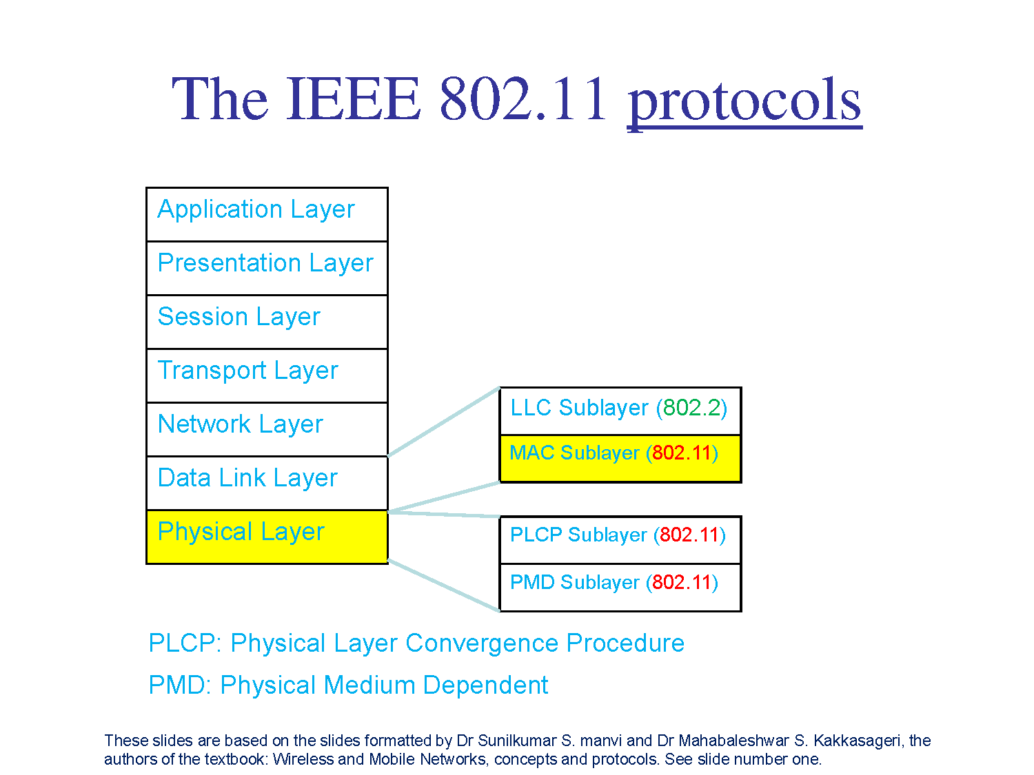

Slide 15
Data Link Layer
The data link layer is an interface between the network and physical layer. The Data Link layer is responsible for organizing the bit-level data for communication between devices on a network and detecting and correcting Physical layer errors. also it is responsible for the multiplexing of data streams and data frame detection
It is further subdivided into two modules:
  Medium Access Control (MAC) plays a critical role in conserving network life by efficiently allocating medium access to the contending nodes.
  Logical Link Control (LLC) is on top of the MAC layer and is responsible for cyclic redundancy check (CRC), sequencing information, and addition of appropriate source and destination information.

Slide 16
Datalink layer - LLC
LLC layer lets the upper layers communicate with any form of transmission media in the same way.
Flow Control, it control the rate of data transmission between two sources and destination hosts
Error detection and correction
LLC layer protocols include specifications for the frames of many types of physical networks, including Ethernet, WIFI, FDDI (Fiber Distributed Data Interface).

Slide 17
Datalink layer -MAC
It maintains, and manages the communications between the access points (AP) and the 802.11 clients.
Coordinate the access to the shared radio channel for all the devices

Slide 18
The Physical Layer
    Physical Layer Convergence Protocol(PLCP): frame exchange between the MAC and PHY, used to indicate data rates and packet length.
    Physical Medium Dependent(PMD): uses signal carrier and modulation to transmit data frames over the media.
      This service interfaces directly to the RF.
      It modulates/demodulates (MODEM) the frame transmissions.
      The examples of modulation are : Direct Sequence Spread Spectrum (DSSS) PHY, The Frequency Hopping Spread Spectrum (FHSS) PHY, AM and FM modulation.

Slide 19
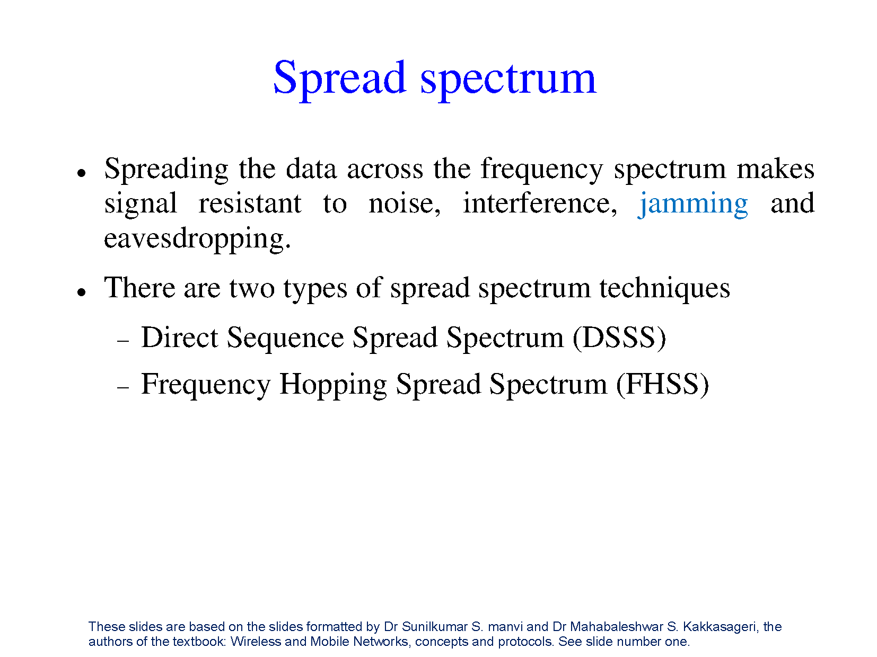

Slide 20
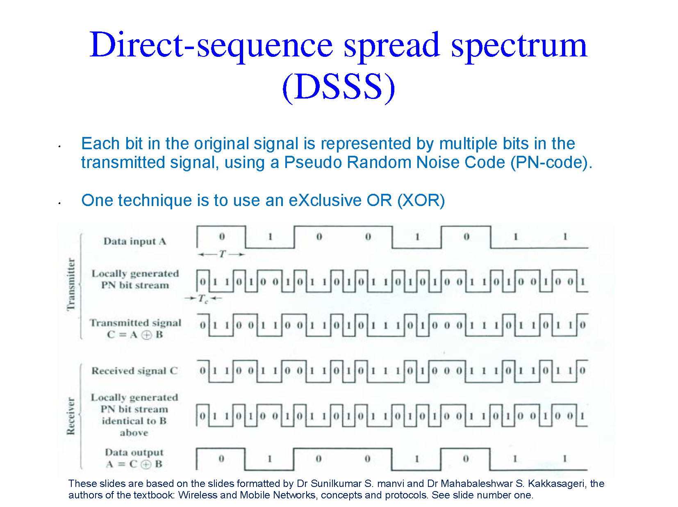

Slide 21
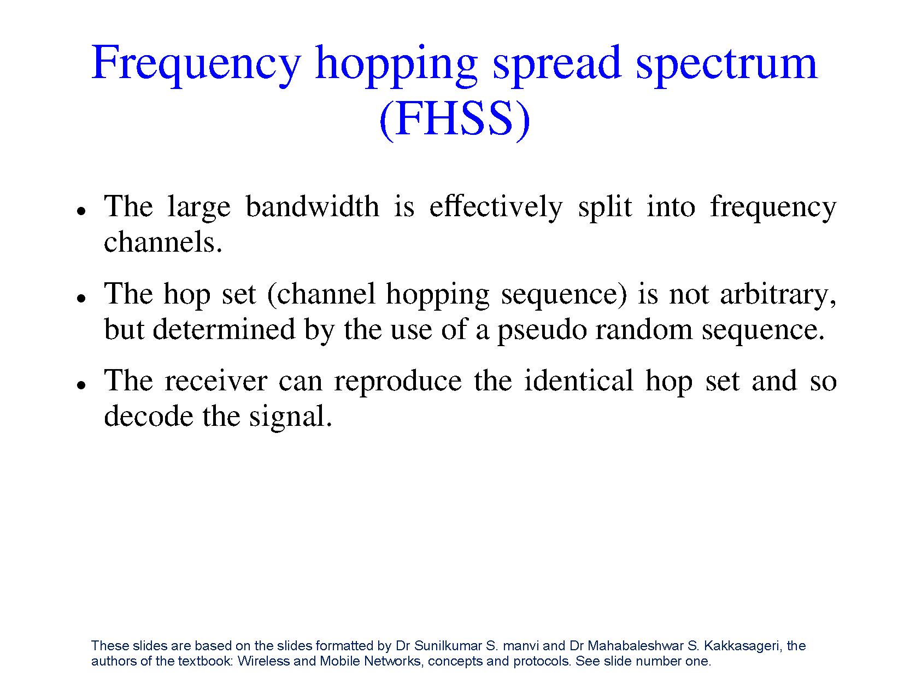

Slide 22
